Slide 1
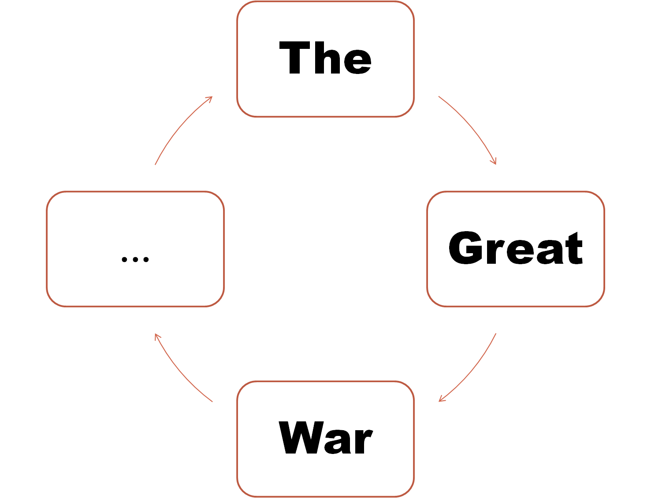
Notes:
‹#›

Slide 2
Notes:
‹#›

Slide 3
MILITARISM
Country | Troops
Germany | 1,900,000
Austria-Hungary | 450,000
Britain | 100,000
France | 1,300,000
Serbia | 200,000
Russia | 1,400,000
*** ARMS RACE***

Slide 4
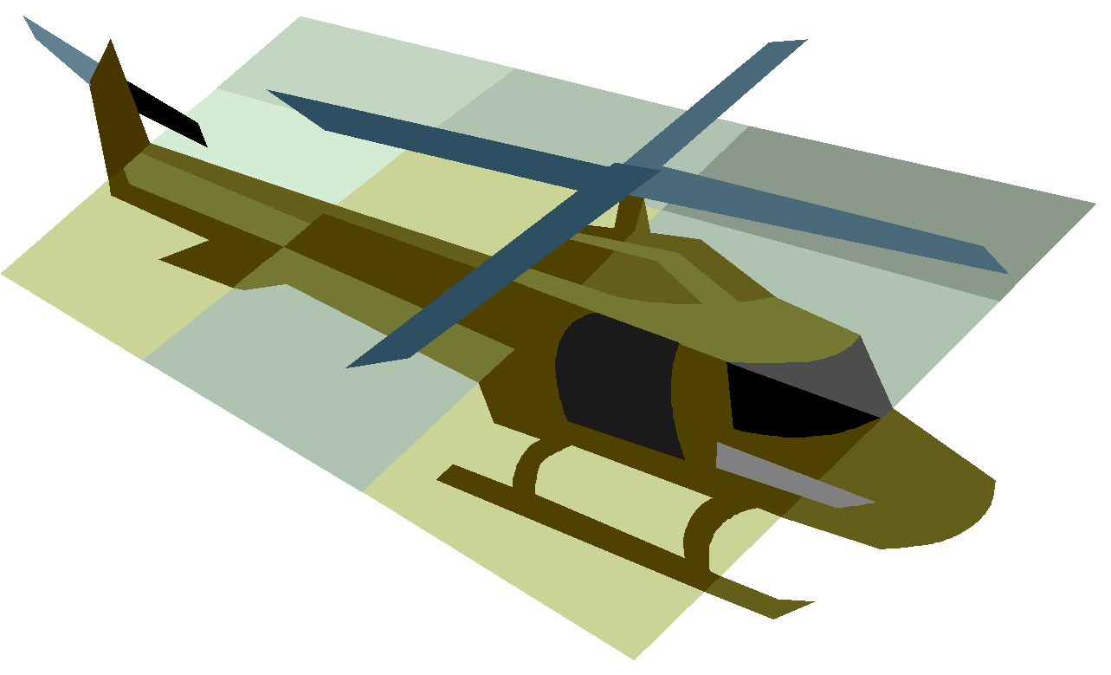
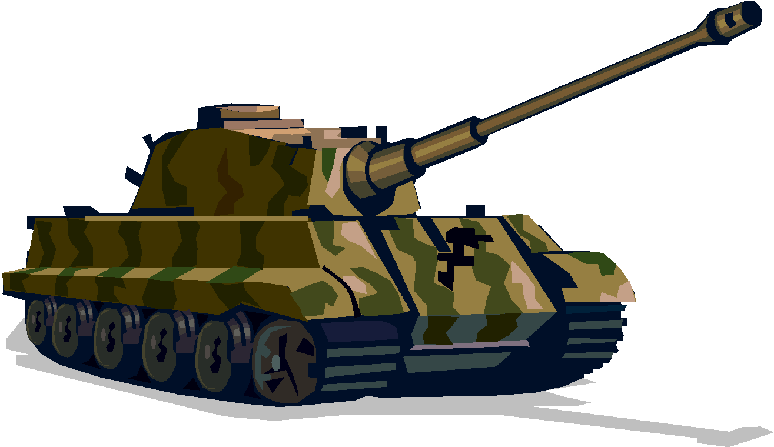
MILITARISM: Total Defense Expenditures for the Great Powers
 | 1910-1914 Increase in Defense Expenditures
France | 10%
Britain | 13%
Russia | 39%
Germany | 73%

Slide 5
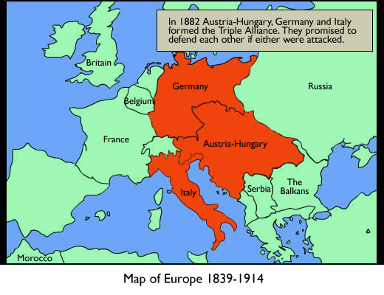
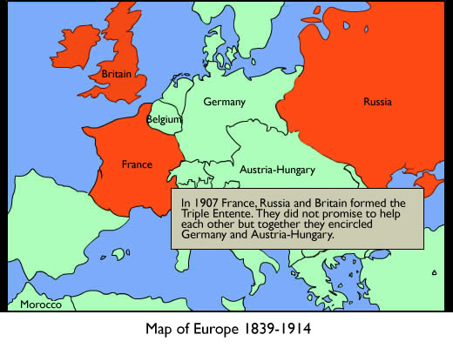
ALLIANCES

Slide 6
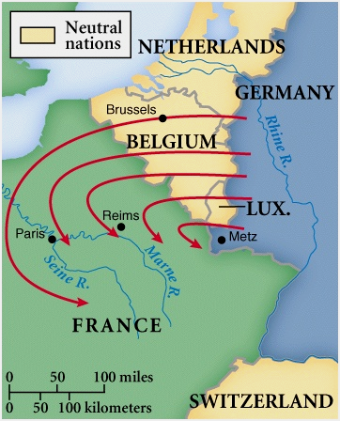
SCHLIEFFEN PLAN

Slide 7
IMPERIALISM
Quest for INDUSTIRL POWER – brings markets, raw materials, prestige
Unification of Germany provided her with the necessity to create stability in nation – PRIORITY
Need economic stability = INDUSTRY
Need respect = LAND
Imperialism could aid in both – must compete to challenge Great Britain & France
This leads to competition and rivalry

Slide 8
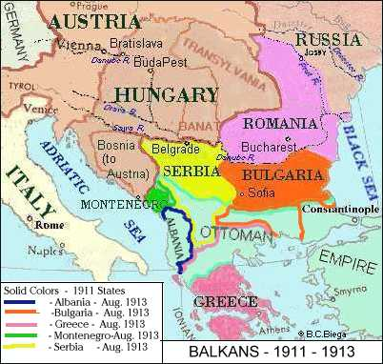
NATIONALISM: Trouble in the Balkans
1908: Austria-Hungary takes control of former Turkish province of BOSNIA – Why?
Russia was gaining to much power in the Balkans – access to Mediterranean Sea
Serbia wanted control of Bosnia – ethnicity
Tensions rise between Serbia and Austria-Hungary
THE POWDER KEG!!!!
***Russia was allied with Serbia*** -- predict!!!!

Slide 9
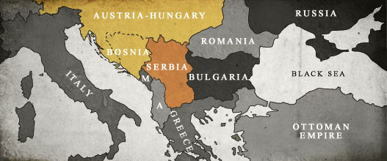
THE SPARK THAT LIT THE FUSE…
The one event that started the Great War happened in the Balkans
The Archduke Franz Ferdinand (Austria-Hungary) was assassinated
The Black Hand (Serbian Nationalists) were responsible….

Slide 10
The Powder Keg + The Spark = WWI

Slide 11
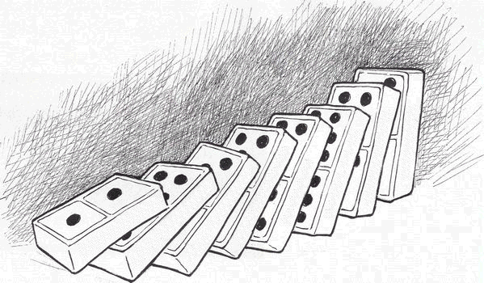
THE GREAT WAR
Notes:
‹#›

Slide 12
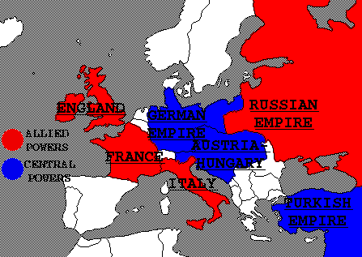
OTTOMAN
Notes:
‹#›

Slide 13
Notes:
Fill in: Great Britain, France, Russia, Italy, Serbia
‹#›

Slide 14
.
Notes:
Fill in: Germany, Austria-Hungary, Ottoman Empire
‹#›

Slide 15
… What about the U.S.?...
Notes:
‹#›

Slide 16
… What about the U.S.?...
CAPITALISM BENEFITS???????
By 1917 US loaned:
--Allies: $2.25 billion
--Central: $27 million
Notes:
‹#›

Slide 17
April 6, 1917 US enters war after a series of events…
Notes:
‹#›

Slide 18
April 6, 1917 US enters war after a series of events…
Notes:
‹#›

Slide 19
… u-boat warfare leads to Sussex Pledge…
Sussex Pledge
…By 1917 The Great War is in a STALEMATE…
Notes:
‹#›

Slide 20
… 1917 Germany violates Sussex Pledge and…
Notes:
‹#›

Slide 21
In addition to “trade” threats… homeland threats loom…
To: Mexico – Neighbor of the U.S.,
whom stole prized land (New Mexico, Texas, Arizona, California)… do you want it back?
German Kaiser Wilhelm II
ATTN: Zimmerman Telegram ATTN: Zimmerman Telegram ATTN: Zimmerma
Notes:
‹#›

Slide 22
Notes:
‹#›

Slide 23
Russia as a World Power
Notes:
‹#›

Slide 24
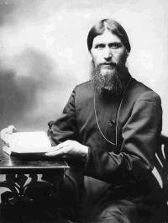
Russia as WWI Power Declines..
Leads to military and morale woes… in the midst of WWI
Notes:
‹#›

Slide 25
The Call for Change… The Russian Revolution of 1917
Notes:
‹#›

Slide 26
The Call for Change… The Russian Revolution of 1917
Notes:
‹#›

Slide 27
Creation of the USSR/ Soviet Union 1922
Stalin 1922-1953
Lenin 1917-1924
Notes:
‹#›

Slide 28
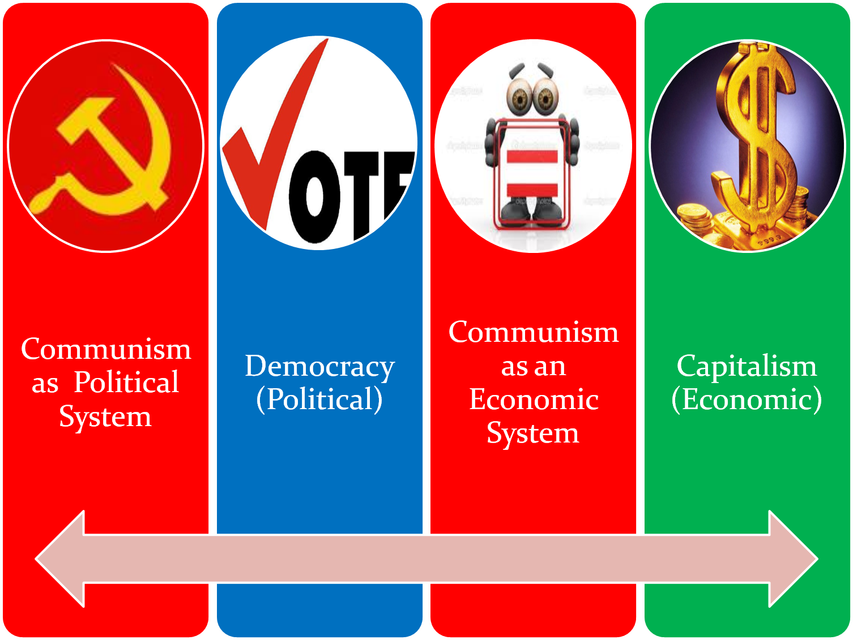
Notes:
‹#›

Slide 29
The Red Scare
1917 Communist Revn in Russia
US fears revolution will occur in US with communist sympathizers
Communists were called “Reds”
Immigration Act 1917
Govt begins to exploit that fear to get rid of people they didn’t like

Slide 30
Palmer Raids:
Attorney General Palmer’s house was supposedly bombed by “Reds”
Palmer orders police to hunt down and arrest any suspected communist, socialist, anarchist
US begins arresting “reds” and even executing them

Slide 31
Sacco & Vanzetti:
Red Scare raised suspicion of foreigners.
Nicola Sacco & Bartolomeo Vanzetti are Italian immigrants who are accused killing a paymaster and his guard for their $15,000 payroll.
The evidence against Sacco & Vanzetti was circumstantial & the judge made prejudicial remarks.
Jury found them guilty and sentenced them to death.

Slide 32
BOSTON POLICE STRIKE: In 1919, Boston Police went on strike for increase in pay. The remaining police were fired.
STEEL MILL STIKE: In 1919, 350,000 workers from the US Steel plant went on strike. Steel company hired private police and used militia to end strike, and killed 18 workers.
Immigration Act 1924:

Slide 33
KKK Rises Again!
As a result of the Red Scare and rise of immigration, KKK came to rise.
KKK devoted to 100% Americanism: White,non-immigrant, Protestant, etc.
By 1924, it boasted over 4.5 million White male members.
Membership included states from Arkansas, California, Indiana, Ohio, Oklahoma, Oregon & Texas.

Slide 34
U.S. Limits Immigration
1918-1921: Red scare aggravates fear & anti-immigrant reaction.
1921-1924: Quota Law – 1st time numerical limits; uses 1910 proportion (3%), favoring north Europeans.
1924 Immigration Act severely limits
because
Racial superiority of Anglo Saxons
Immigrants cause lowering of wages
Do not assimilate
Threat to national identity & unity
Limits immigrants to 2% of their national group in 1890, thus against south & east Europeans

Slide 35
Notes:
‹#›

Slide 36
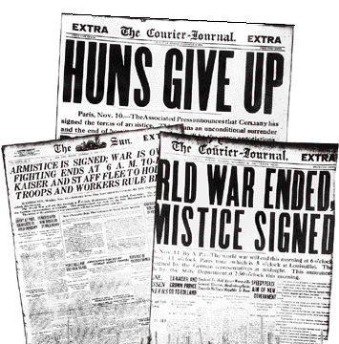
ARMISTICE!!!!
ARMISTICE!!!!
Notes:
‹#›

Slide 37
Plan delivered to US Congress by President Woodrow Wilson
Notes:
‹#›

Slide 38
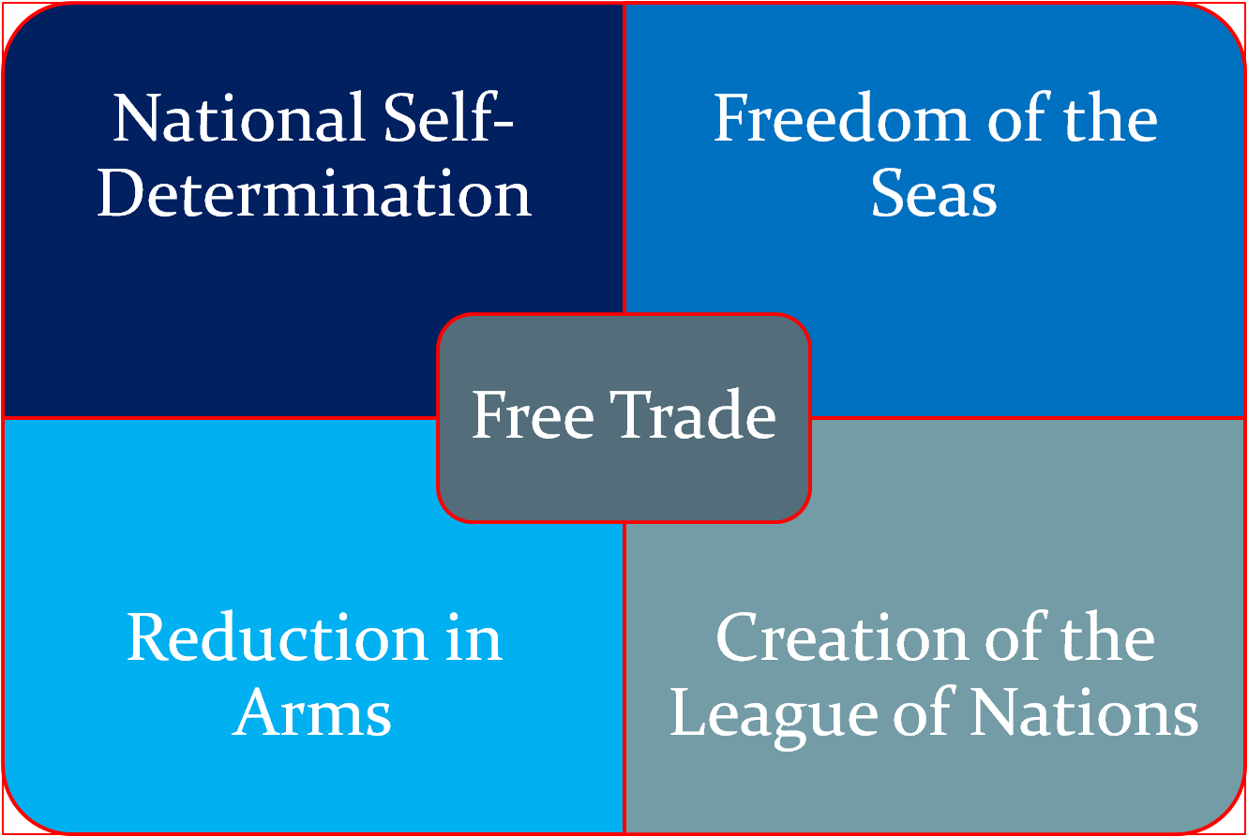
Goals of Wilson’s 14 Points
Notes:
‹#›

Slide 39
The Fourteen Points:
Notes:
‹#›

Slide 40
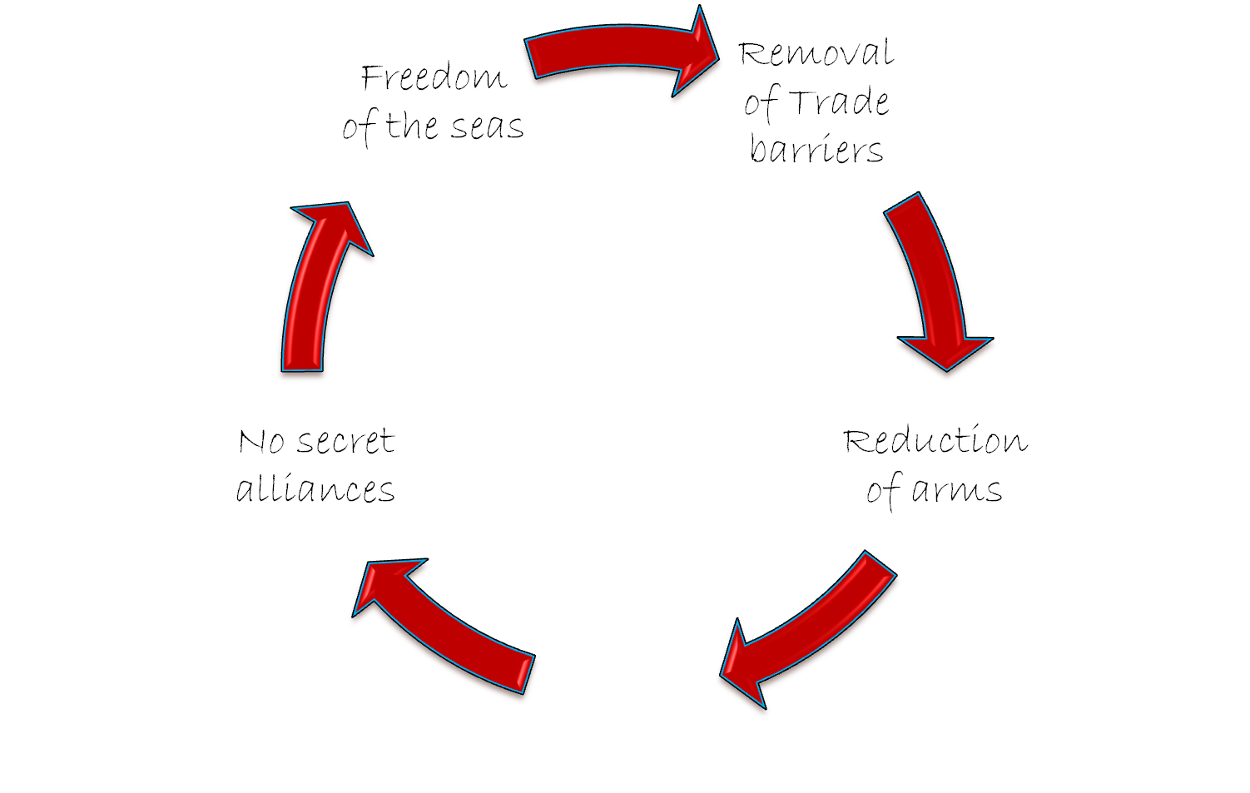
OPEN DIPLOMACY
WILSON’S 14 POINTS
WILSON’S 14 POINTS
Notes:
‹#›

Slide 41
As the countries negotiate peace… the dynamics of Europe play a role
Notes:
‹#›

Slide 42
Differing Desires…
Notes:
‹#›

Slide 43
The Treaty of Versailles 1919
Not a treaty of reconciliation
June 28, 1919=signed
Very harsh—Germany—they resented
Notes:
‹#›

Slide 44
The Treaty of Versailles 1919
Notes:
‹#›

Slide 45
The Treaty of Versailles 1919
Notes:
‹#›

Slide 46
The Treaty of Versailles 1919
GERMANY MUST…
Notes:
‹#›

Slide 47
The Treaty of Versailles 1919
GERMANY MUST…
Notes:
‹#›

Slide 48
US never signs the Treaty of Versailles ---- Why??

